Slide 1
Community PSE Exploration Process Summary Infographic Template
You have spent a lot of time and effort engaging in the Community PSE Exploration Process to better understand the communities you serve and make informed decisions about future PSE efforts in your SNAP-Ed work. This template is built to highlight your key findings plain language to share with others.
For now, we want you to try this template out in our EWG sessions. Use the Exploration Process guides and worksheets to enter information into this template. You will present your final summary at the next EWG sessions in July and August.
How to use:
At the top margin of each page, there is an outlined text box with a star icon that includes a short overview of key point of the page and which questions from your worksheets to use to answer the prompts.
Highlighted text is meant to be replaced with your own words using the prompts in the margins.
Look to the last three pages as an example of how to format.

Slide 2
Page 1 provides an overview of the Community PSE Exploration process and the community you implemented it in. You will use your answers from step 1, questions 1-4 to complete this page.
Enter your organization and/or SNAP-Ed program here
[Organization] engaged local residents and organizations in [X Community] in a community exploration process to make healthy changes where people:
Enter the name of the community you conducted the exploration in here. NOTE: Even if you completed the exploration in multiple communities, you should only focus on one per infographic.
Live
Learn
Eat
Play
Shop
Work
The community exploration process brings people together to talk about how to make our community healthier, building on existing assets and efforts. This initiative is part of healthy eating and active living programming supported by Supplemental Nutrition Assistance Program Education (SNAP-Ed) at Michigan Fitness Foundation.
Think about what kind of engagement you did in Step 1 (Discovery). In the highlighted areas of the first sentence, enter the specific things you did to contribute to the community discovery phase.
Steps Taken
EXAMPLES:
Method(s):
Talked
Held focus groups
Held listening sessions
Used surveys
Type(s) of community member(s):
Specific groups of people
in X county / town / city / neighborhood
[Insert method(s)] with [type(s) of community member(s)] to discover community need.
Thank you to those who contributed!
Summarized the information we gathered and prioritized top issues.
Organization
Partner
Residents of [X community]
The community exploration process cannot be done alone! Enter the names of organizations, partners, community champions, etc. that helped you complete the process. Be sure you include at least a general statement about acknowledging the residents (e.g., “Residents of X Community).
Created an action plan based to work towards community change related to the top issues.
The community context section is a snapshot of the community, including key characteristics that you heard during the discovery phase. Select and list the top 5-7 pieces of information that community members shared. Consider a strengths-based approach when selecting aspects of the community that have a strong impact on improving the quality of life.
Community Context
OPTIONAL: Click the county on the map of Michigan that you completed the exploration process in. Drag it into the white space.
Residents
Culture
History
Business
Government
Nonprofits
Programs
Policies
Plans
Systems
Resources
Environments (physical)
Through engaging with [X Community] residents and organizations, we discovered [insert community context here].
OPTIONAL: Include a photo that represents your community (e.g., a community hub, a welcome sign into the town/city, etc.)
Insert your logo here
This institution is an equal opportunity provider.
This project was funded in whole or in part by the USDA’s Supplemental Nutrition Assistance Program Education through the Michigan Department of Health and Human Services and the Michigan Fitness Foundation.

Slide 3
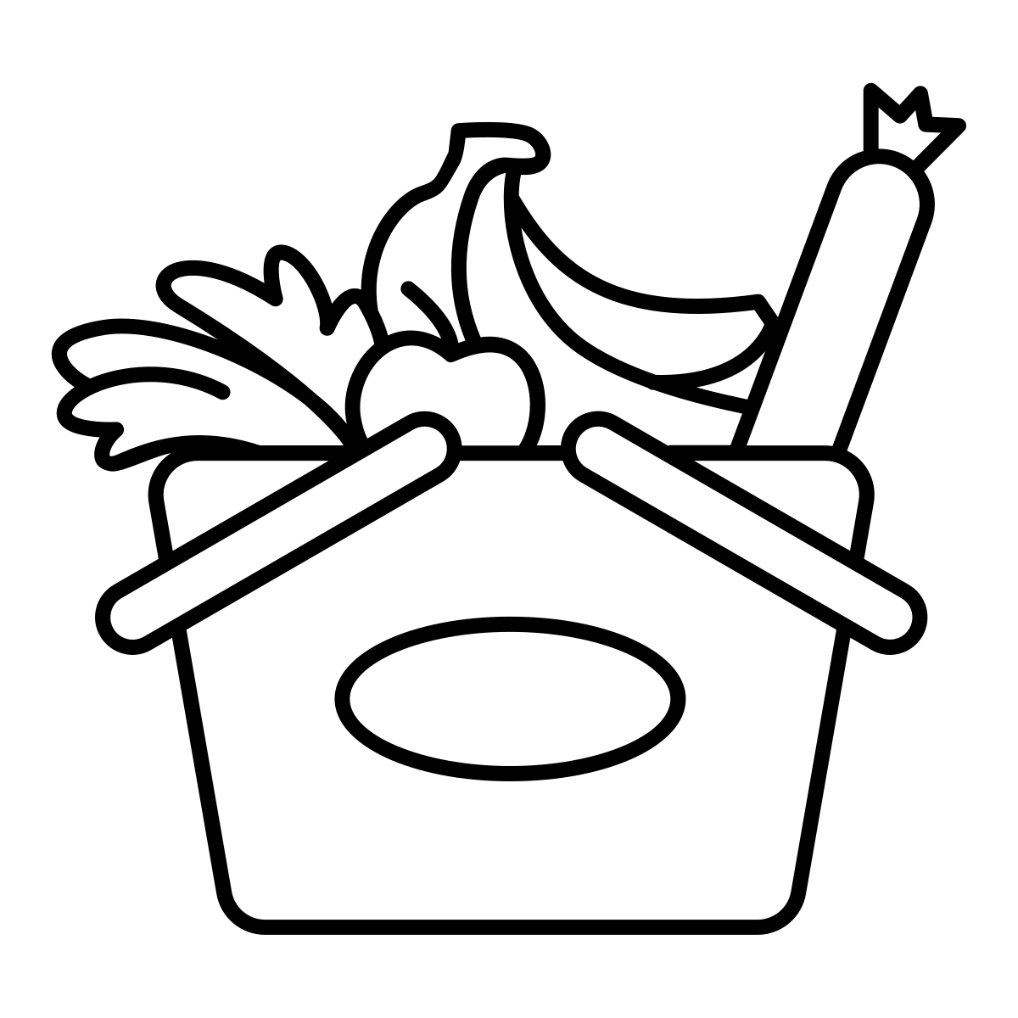
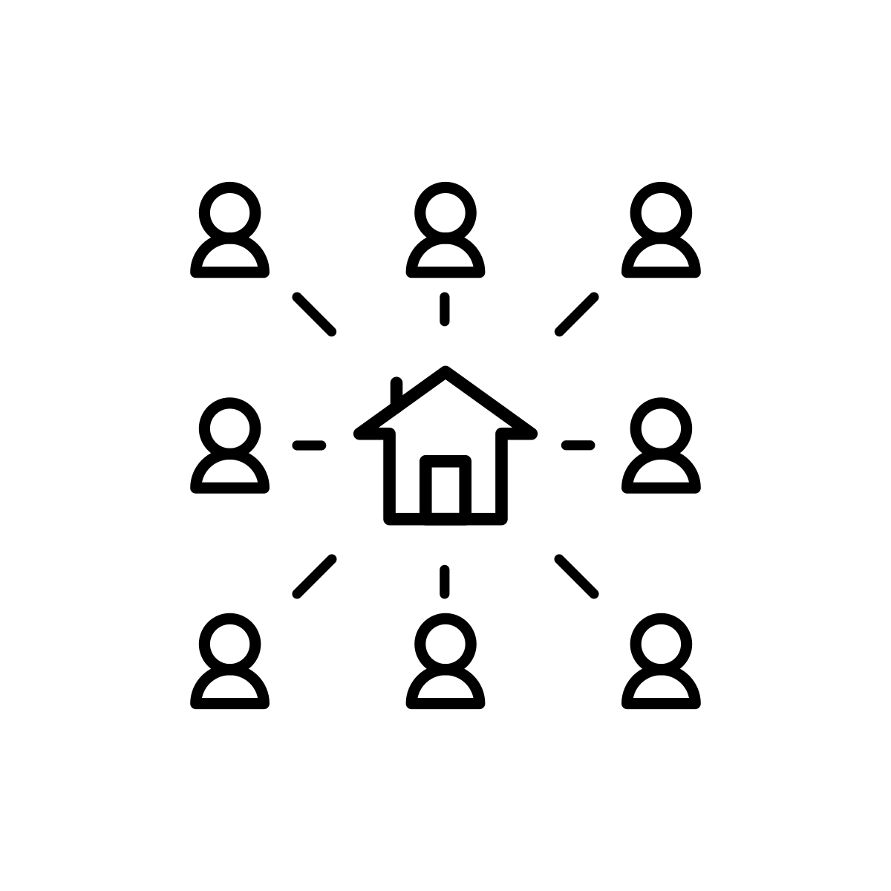
Page 2 lists the community strengths and assets as well as issues, barriers, concerns, and/or needs you discovered from your community during step 1. You will use your answers from step 1, questions 5-9 and step 2, questions 1 and 2 to complete this page.
The following icons can represent some of the strengths/assets AND issues/barriers/concerns/needs you discovered. Copy and paste or drag these icons in the corresponding orange circles.
We discovered the following strengths and assets in the community:
Enter the strengths and assets you discovered from your community in step 1. (See list below for examples and inspiration.)
Then, copy and paste or drag in one of the icons on the right that represent that strength or asset.
Asset
Asset
Asset
The following list can describe both strengths/assets AND issues/barriers/concerns/needs. You can borrow directly from this list or use it as inspiration.
Access to fresh healthy food
Access to land with soil suitable for growing food
Access to quality healthcare
Access to resources and support in their first language
Active and inclusive neighborhood/block club
Affordable childcare
Affordable housing
Business that “give-back” to the community with time and/or financial support
City Master Plans with goals to make healthy living more accessible
Cost of food
Consistent reliable public transportation
Farmer’s markets
Food banks
Green space
Grocery stores
Grocery stores with fresh produce / healthy foods & accepts EBT
Housing Assistance Programs
Local farm produce that accepts EBT
Local politician that integrates health issues across the policy platform
Maintained Parks with space for a variety of activities
Safety [safe parks, maintained sidewalks, blight]
Specific organizations promoting healthy food and/or physical activity, e.g. library, community center, business, church, etc.
Specific community organizers/associations/nonprofits, services
Transportation to places with fresh food
Transportation to places with (physical) activities that are enjoyable
Walkable neighborhood/ pathways to health food/ parks/ gardens
Youth/ Elder Advisory Groups
Asset
Asset
Asset
We discovered the following issues the community is facing:
Enter the issues, barriers, concerns, and/or needs you discovered from your community in step 1. (See list to the left for examples and inspiration.)
Then, copy and paste or drag in one of the above that represent that barriers, concerns, and/or need.
Issue
Issue
Issue
Issue
Issue
Issue
OPTIONAL: If applicable, drag the text box below to some of the white space on the page to include direct quotes from your exploration process.
Insert a quote in this box from a participant to reinforce your story.
- Participant

Slide 4
The top of page 3 describes the prioritization process you used to rank top community issues during step 2. You will use your answers from step 2 (Prioritizing Strategies), questions 3-4 to complete the top half of the page.
The bottom of page 3 includes next steps you plan to take with this information. Depending on where you are in the process, you will use your answers from step 2, questions 8-11 to describe how you will prioritize PSE strategies and keep the conversation going. OR, you will use your answers from step 3, question 2 to describe your action plan.
Prioritization
Insert a description of your process for getting input about which health issue is most important to the community. Include:
Who you talked with and what you asked them
Any benefit or feasibility analysis
[Insert your process here.] Based on this process, we decided to focus on the following issues.
List at least the top three priority issues you and your community decided on. Copy and paste the corresponding icons from the community strengths and issues page into the green circles.
If you want to include more than three priorities, copy and paste the green circles.
[priority #1]
[priority #2]
[priority #3]
Next Steps
[Insert summary.]
[Insert next steps.]
Describe the next steps in your process, no matter where you are. Be specific. Include details such as:
How are you going to continue the conversation?
What is the community going to do?
Who is responsible for making sure it gets done?
When does it need to be done?

Slide 5
EXAMPLE!

Slide 6
Page 1 provides an overview of the Community PSE Exploration process and the community you implemented it in. You will use your answers from step 1, questions 1-4 to complete this page.
Enter your organization and/or SNAP-Ed program here
The Michigan Fitness Foundation engaged local residents and organizations in the Fake neighborhood in Lansing in a community exploration process to make healthy changes where people:
Enter the name of the community you conducted the exploration in here. NOTE: Even if you completed the exploration in multiple communities, you should only focus on one per infographic.
Live
Learn
Eat
Play
Shop
Work
The community exploration process brings people together to talk about how to make our community healthier, building on existing assets and efforts. This effort is part of healthy eating and active living programming supported by Supplemental Nutrition Assistance Program Education (SNAP-Ed) at MFF.
Think about what kind of engagement you did in Step 1. In the highlighted areas of the first sentence, enter the specific things you did to contribute to the community discovery phase.
Steps Taken
EXAMPLES:
Method(s):
Talked
Held focus groups
Held listening sessions
Used surveys
Type(s) of community member(s):
Specific groups of people
in X county / town / city / neighborhood
Held listening sessions with residents in Fake Neighborhood to discover community need.
Thank you to those who contributed!
Summarized the information we gathered and prioritized top issues.
Fake neighborhood shops and businesses
Fake Neighborhood Center
Residents of Fake Neighborhood, Lansing
The community exploration process cannot be done alone! Enter the names of organizations, partners, community champions, etc. that helped you complete the process. Be sure you include at least a general statement about the residents of the community.
Created an action plan based to work towards community change related to the top issues.
The community context section is a snapshot of the community including key characteristics that you heard during the discovery phase. Select and list the top 5-7 pieces of information that community members shared. Consider a strengths-based approach when selecting aspects of the community that have a strong impact on improving the quality of life.
Community Context
OPTIONAL: Click the county on the map of Michigan that you completed the exploration process in. Drag it into the white space.
Residents
Culture
History
Business
Government
Nonprofits
Programs
Policies
Plans
Systems
Resources
Environments (physical)
Through engaging with Fake Neighborhood residents and organizations, we discovered Fake Neighborhood is a very tight-knit neighborhood in the state’s capital area. Most buildings were created in the early 1900’s and the infrastructure and roads are aged. The neighborhood is very walkable to local shops and businesses, but not many with affordable healthy foods. The Grand River runs through the neighborhood, creating opportunity for free physical activity. The residents are mostly immigrants, with English being their second language.
OPTIONAL: Include a photo that represents your community (e.g., a community hub, a welcome sign into the town/city, etc.)
Insert your logo here
This institution is an equal opportunity provider.
This project was funded in whole or in part by the USDA’s Supplemental Nutrition Assistance Program Education through the Michigan Department of Health and Human Services and the Michigan Fitness Foundation.

Slide 7
Page 2 lists the community strengths and assets as well as issues, barriers, concerns, and/or needs you discovered from your community during step 1. You will use your answers from step 1, questions 5-9 and step 2, questions 1 and 2 to complete this page.
The following icons can represent some of the strengths/assets AND issues/barriers/concerns/needs you discovered. Copy and paste or drag these icons in the corresponding orange circles.
We discovered the following strengths and assets in the community:
Enter the strengths and assets you discovered from your community in step 1. (See list below for examples and inspiration.)
Then, copy and paste or drag in one of the icons on the right that represent that strength or asset.
Walking Trails
Immigrant Populations
We are a really close community. Everyone in the neighborhood knows each other.
- Fake Neighborhood Resident
The following list can describe both strengths/assets AND issues/barriers/concerns/needs. You can borrow directly from this list or use it as inspiration.
Access to fresh healthy food
Access to land with soil suitable for growing food
Access to quality healthcare
Access to resources and support in their first language
Active and inclusive neighborhood/block club
Affordable childcare
Affordable housing
Business that “give-back” to the community with time and/or financial support
City Master Plans with goals to make healthy living more accessible
Cost of food
Consistent reliable public transportation
Farmer’s markets
Food banks
Green space
Grocery stores
Grocery stores with fresh produce / healthy foods & accepts EBT
Housing Assistance Programs
Local farm produce that accepts EBT
Local politician that integrates health issues across the policy platform
Maintained Parks with space for a variety of activities
Safety [safe parks, maintained sidewalks, blight]
Specific organizations promoting healthy food and/or physical activity, e.g. library, community center, business, church, etc.
Specific community organizers/associations/nonprofits, services
Transportation to places with fresh food
Transportation to places with (physical) activities that are enjoyable
Walkable neighborhood/ pathways to health food/ parks/ gardens
Youth/ Elder Advisory Groups
Walkability
Local Schools
We discovered the following issues the community is facing:
Enter the issues, barriers, concerns, and/or needs you discovered from your community in step 1. (See list to the left for examples and inspiration.)
Then, copy and paste or drag in one of the above that represent that barriers, concerns, and/or need.
Access to Healthy Foods
Safety
Affordable Housing
Inequitable Systems
Neighborhood Policies
No Local Food Pantries or Affordable Grocery Stores
OPTIONAL: If applicable, drag the text box below to some of the white space on the page to include direct quotes from your exploration process.

Slide 8
The top of page 3 describes the prioritization process you used to rank top community issues during step 2. You will use your answers from step 2, questions 3-4 to complete the top half of the page.
The bottom of page 3 includes next steps you plan to take with this information. Depending on where you are in the process, you will use your answers from step 2, questions 8-11 to describe how you will prioritize PSE strategies and keep the conversation going. OR, you will use your answers from step 3, question 2 to describe your action plan.
Prioritization
Insert a description of your process for getting input about which health issue is most important to the community. Include:
Who you talked with and what you asked them
Any benefit or feasibility analysis
While talking with community members, we asked them what largest hope for the neighborhood was. We also thought about the resources and connections we had to be able to address these issues. Based on this process, we decided to focus on the following issues.
List at least the top three priority issues you and your team decided on. Copy and paste the corresponding icons from the community strengths and issues page into the green circles.
If you want to include more than three priorities, copy and paste the green circles.
Access to Healthy Foods
No Local Food Pantries or Affordable Grocery Stores
Safety
Next Steps
Focusing on these priority issues, we want to create community change in Fake Neighborhood that increases access to healthy, affordable foods and promotes safe areas to engage in physical activity.
We are going to continue the conversations around these areas with partners, coalitions, and community change makers. We are gathering these partners and holding another listening session to learn more about what the Fake Neighborhood residents want to see.
Describe the next steps in your process, no matter where you are. Be specific. Include details such as:
How are you going to continue the conversation?
What is the community going to do?
Who is responsible for making sure it gets done?
When does it need to be done?

