Slide 1

SNAP-Ed University Wrap-Up: Identifying Key Insights and Applying Key Concepts
FACILITATED BY
Patrilie Hernandez, MS (they/she)
Ashley Brafman (she/her)

Slide 2
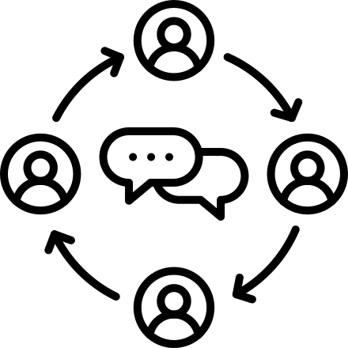
Collective Agreements
  Share courageously and listen generously.
  Feel free to speak your truth while knowing it's only part of the truth.​
  Recognize that the process is as important as the outcome(s).
  Allow yourself to sit with the emotion of discomfort.
  Expect and accept non-closure.
  Enter interactions with grace and accountability.
Image description: a circle of people with speech bubbles around them
August
2024
Embody Lib
www.embodylib.com
Notes:
Every community owes its existence and vitality to generations from around the world who contributed their hopes, dreams, and energy to making the history that led to this moment. Some were brought here against their will, some were drawn to leave their distant homes in hope of a better life, and some have lived on this land for more generations than can be counted. Truth and acknowledgment are critical to building mutual respect and connection across all barriers of heritage and difference. We begin this effort to acknowledge what has been buried by honoring the truth. I acknowledge the land in which I occupy today is the land of the Nacotchtank (Anacostan) and part of the Piscataway territory.
I invite you to type the land you currently occupy in the chat. If you would like to look it up, please visit https://native-land.ca/ and enter in your location.
Please take a moment to consider the many legacies of violence, displacement, migration, and settlement that bring us together here today. Acknowledgment of this sacred land and its people is but a first step. It does not stand in for relationship and action, but can begin to point toward deeper possibilities for decolonizing relationships with people and place.

Slide 3
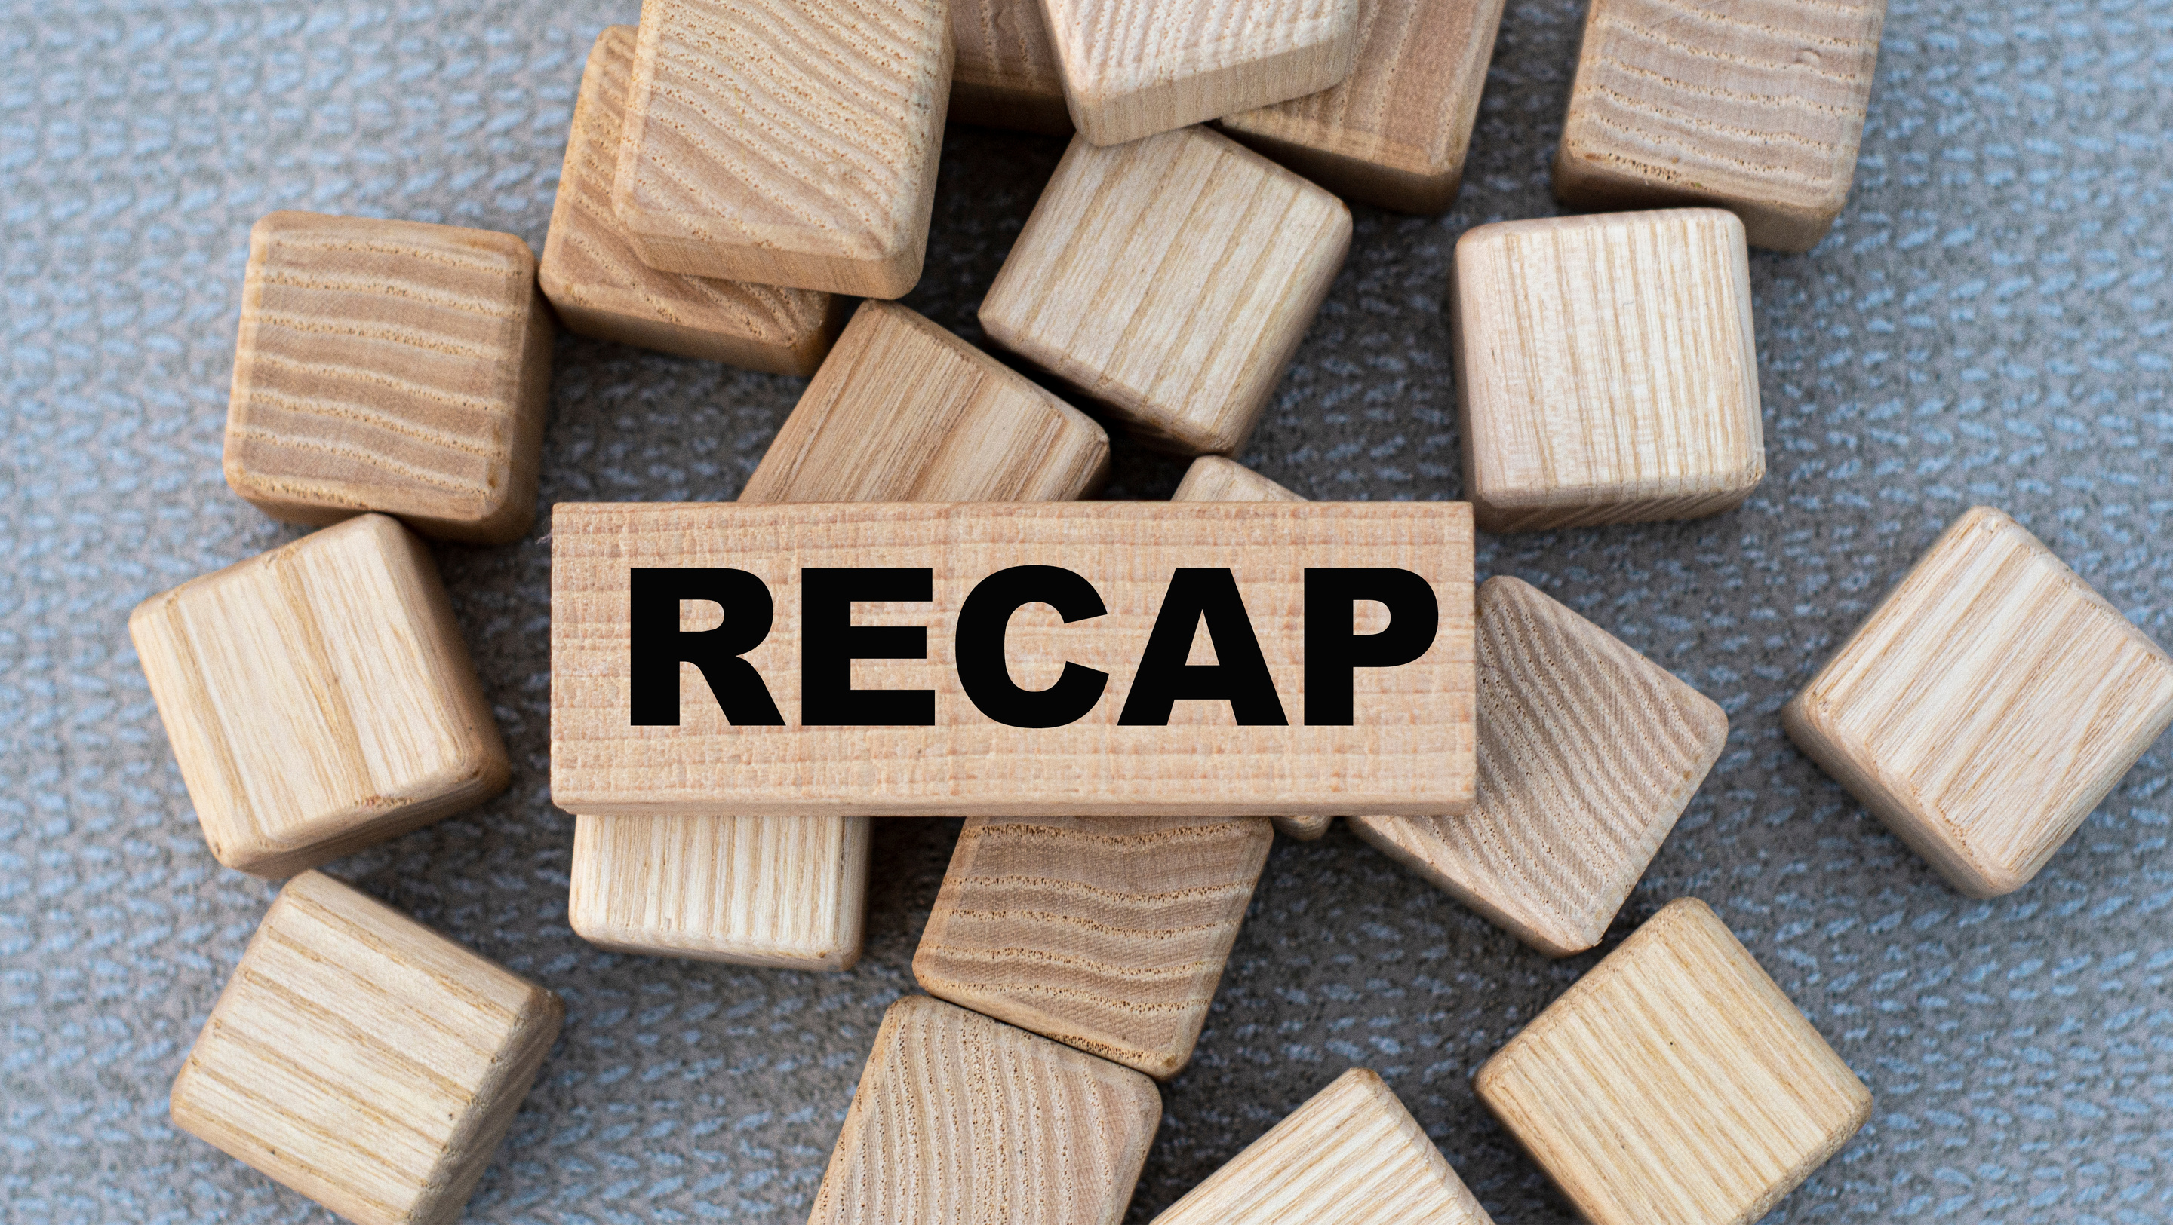

August
2024
Embody Lib
www.embodylib.com

Slide 4

Group Warm-Up:
This or That?

Slide 5


This or That?
August
2024
Embody Lib
www.embodylib.com

Slide 6


This or That?
August
2024
Embody Lib
www.embodylib.com

Slide 7
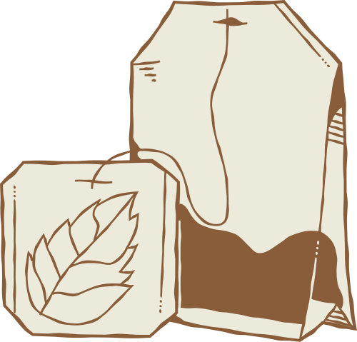
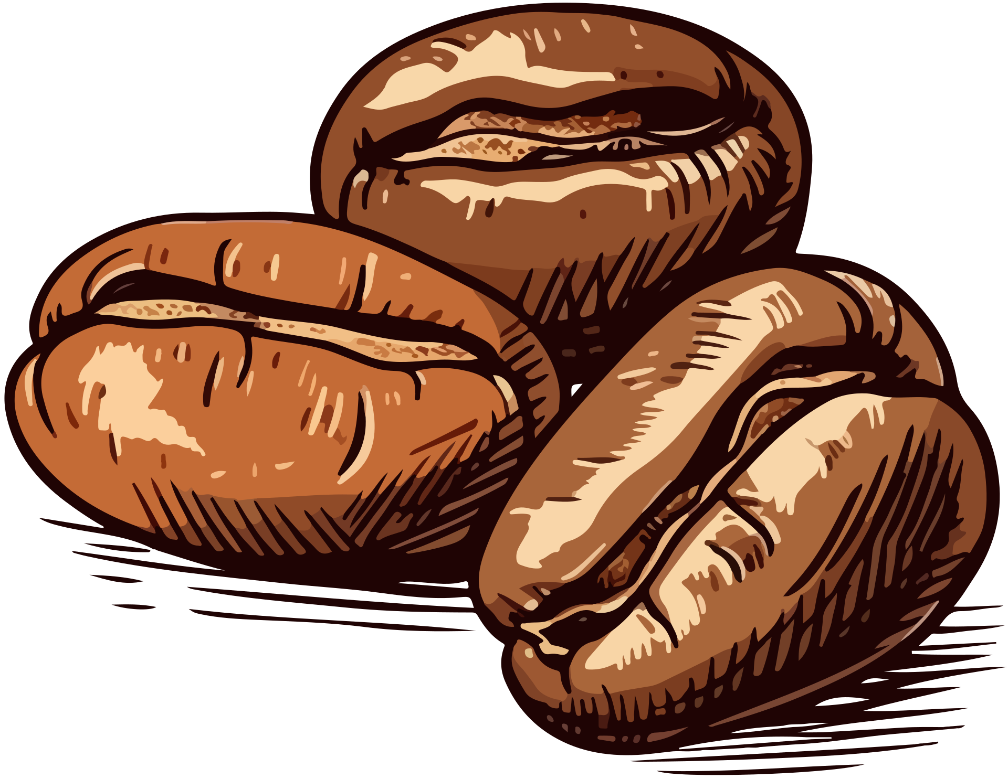
This or That?
August
2024
Embody Lib
www.embodylib.com

Slide 8
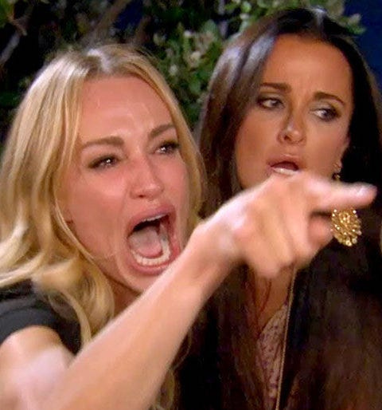

This or That?
Reality TV
Scripted Sitcom
August
2024
Embody Lib
www.embodylib.com

Slide 9


This or That?
August
2024
Embody Lib
www.embodylib.com

Slide 10
This or That?
Direct
Education
Policy, Systems Environment
August
2024
Embody Lib
www.embodylib.com

Slide 11
Using Storytelling to Share ‘Aha!’ Moments

Slide 12
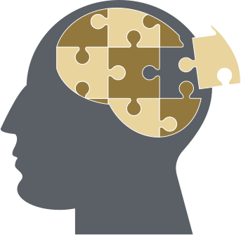
Instructions
  Step 1: Think of a situation you are grappling with in your SNAP-Ed work that has challenged you in the past, is currently challenging you, or is something you think you will be challenged with in the near future.
  Step 2: Share a personal story that illustrates this challenge in 3 minutes or less. Finish the story with:
“Now, after knowing what I learned at SNAP-Ed University, I would have addressed (insert the challenge) differently by (insert action here) OR I will do x,y,z to address (insert challenge) in the future”
Image Description: a person's head with puzzle pieces in it
August
2024
Embody Lib
www.embodylib.com

Slide 13
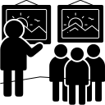
Summarize and Gallery Wallk
Summarize your lesson on a post-it.
Place on the session title it best relates to:
  Spectrum of Cultural Awareness & Sensitivity
  New Resources
  Grant Operations
  SNAP-Ed Guidance
  Decision-Making in Program Adaptations
  Reporting & Evaluation
Image Description: A illustration graphic of a person standing next to a
group of people, looking at pictures hung on the wall
August
2024
Embody Lib
www.embodylib.com

Slide 14
Action Planning

Slide 15


Individual reflection
One way you will ensure the action item is sustainable and one way you can hold yourself accountable to your commitment.
One action item you are going to integrate into your practice
August
2024
Embody Lib
www.embodylib.com
Notes:
How have our personal lived experiences taught us how to care for ourselves?
How have our ANCESTORS taught us to care for ourselves?
How can we take into account our individual needs, preferences, and capabilities?
How can we create balance between what influences health and what our bodies NEED and are ASKING FOR

Slide 16
Discuss at your table
  What came up in your individual reflection?
  What roledoes cultural awareness and sensitivity, namely cultural responsiveness, play in your action item?
Image description: a graphic of three people
August
2024
Embody Lib
www.embodylib.com

Slide 17
Closing Thoughts

Slide 18
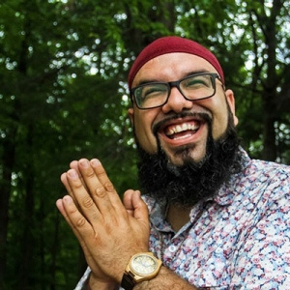
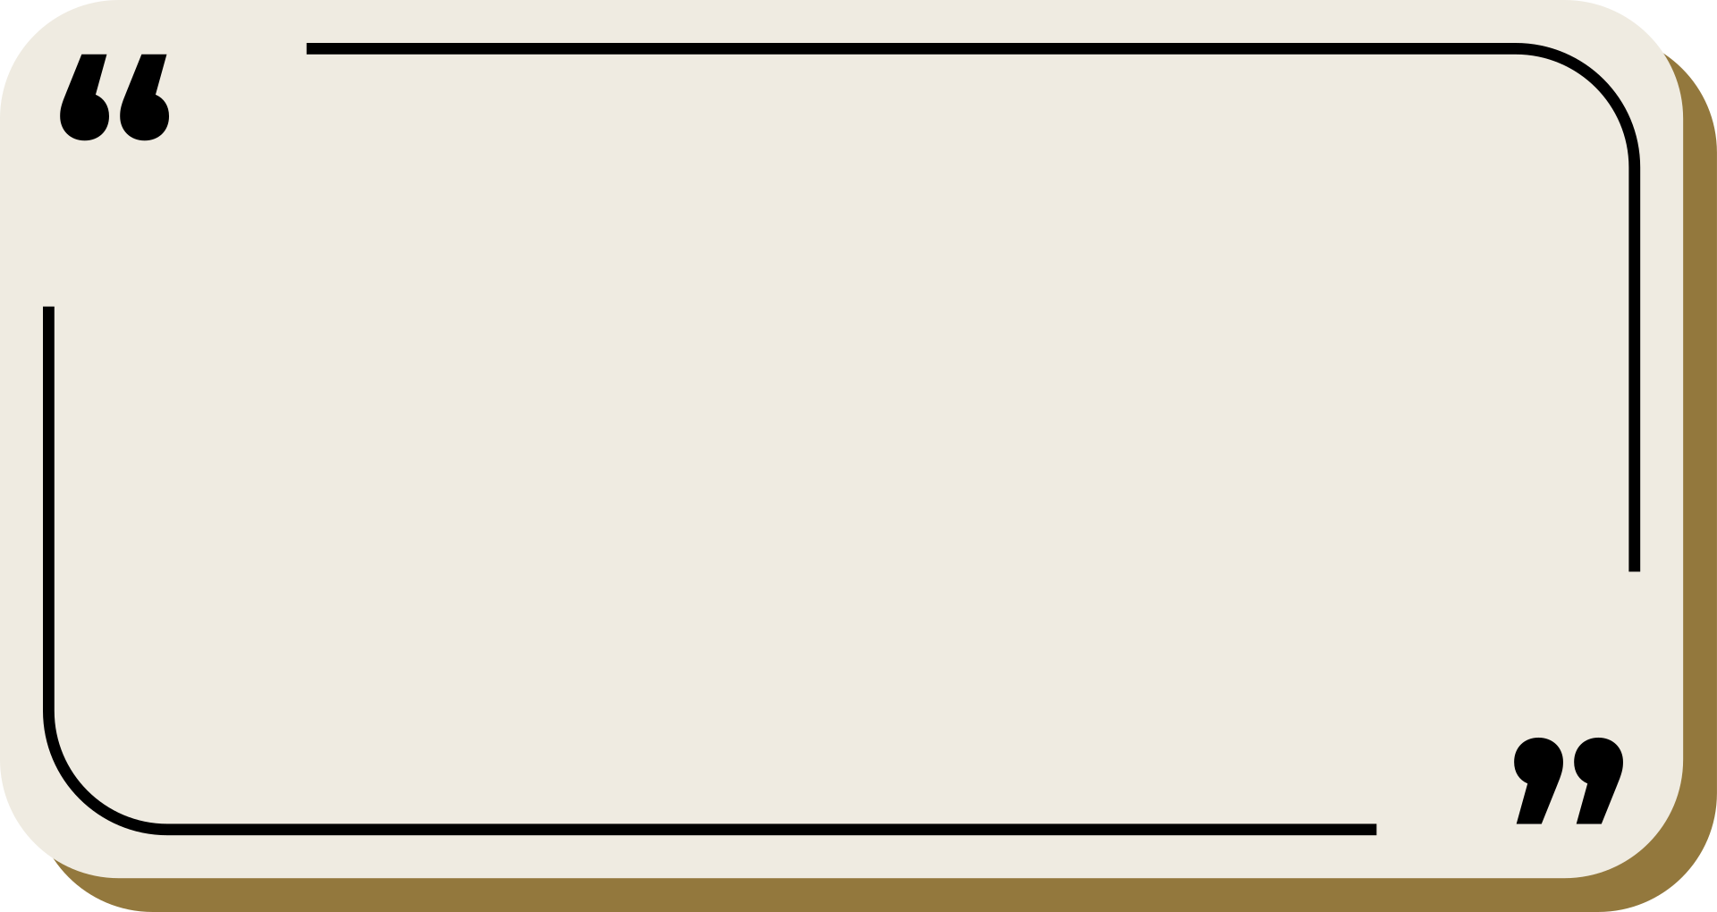
How do you like to be held accountable?
I think that for me, the process of accountability has been a gift. And the ways in which I can be accountable to myself and the people I love in my community increase my capacity and ability to be whole, to be healthier, and to be able to walk in the world in the way that I wanna walk in the world. Which makes me someone who can be proud of the example that I'm giving, not just the rhetoric I'm spittin, you know? … I had to realize that there are some people who love me so much that their critique was not actually an attempt to tell me that I wasn't worthy. It was actually them showing my worth. You're worthy of hearing ways in which you can be a better person in this relationship, in this community, in this world.
Image description: A photgraph of Eroc Arroyo-Montano, educator, artist, facilitator, and community activist, smiling joyously at the camera
August
2024
Embody Lib
www.embodylib.com

Slide 19
Q&A

