Slide 1

How to Reach Gen Z
HIGHSCHOOL
HIGHSCHOOL
HIGHSCHOOL
HIGHSCHOOL
Discipleship in a Postmodern World

Slide 2
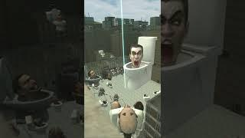

Slide 3


Slide 5


Slide 6


Slide 7


Slide 8
Why are kids drawn to these videos?
Notes:
If you are going to talk to Gen Z, you have to understand Gen Z.

Slide 9


Slide 10


Slide 11
Is Gen Z more or less depressed than other generations?
Notes:
If you are going to talk to Gen Z, you have to understand Gen Z.

Slide 12
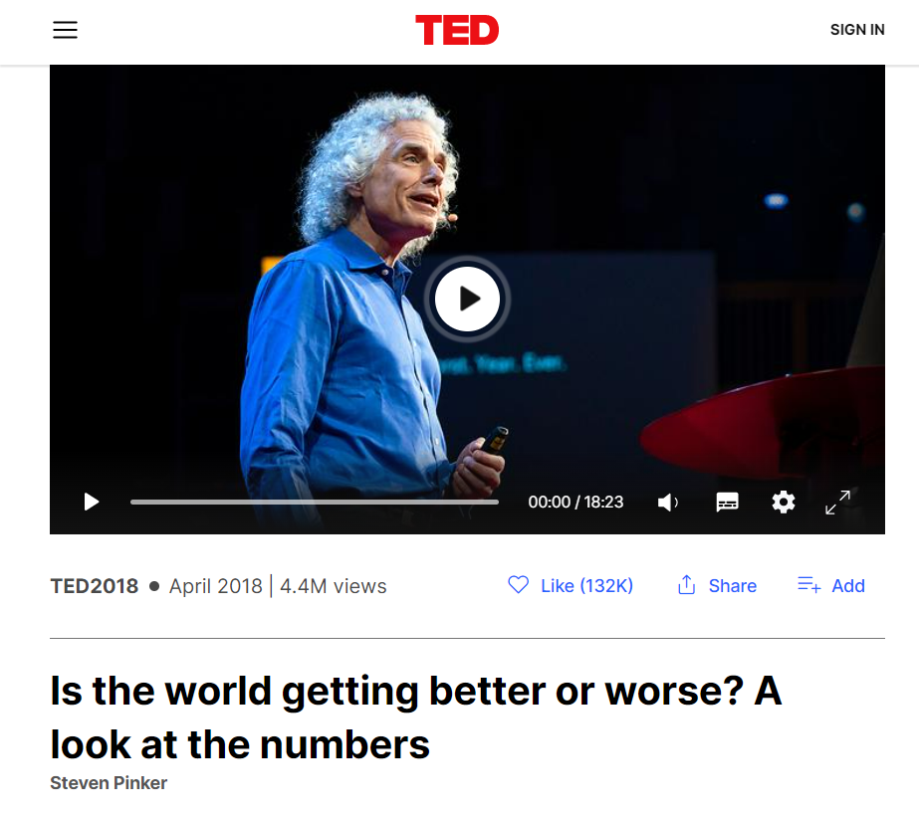
Notes:
The problem is not so much how the world actually is; the problem is how Gen Z perceives the world.

Slide 13
Is America getting better? - Steven Pinker
USA from 1988 to 2018:
48% decrease in homicide
42% decrease in poverty

Slide 14
Is the world getting better? - Steven Pinker
World statistics from 1988 to 2018:
76% decrease in wars
30% decrease in autocracies
78% decrease in extreme poverty

Slide 15
Mental Health Stats
From 2009 to 2017:
47% increase in depression among adolescents 12-13 yrs old
60% increase in depression among young adults (14-27 yrs old)

Slide 16
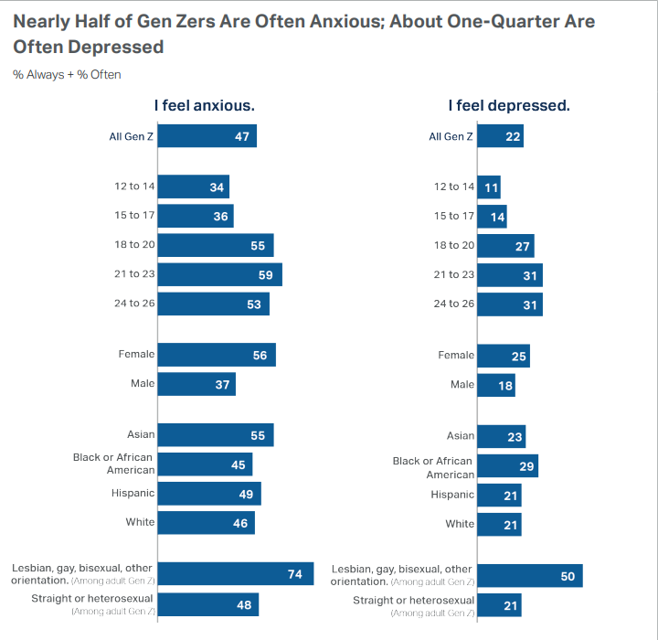


Slide 17
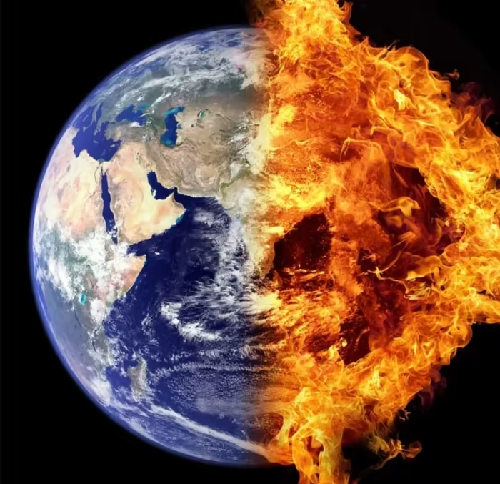
We’re all dying!!!
You wippersnappers don’t know how good you got it!!

Slide 18
Nihilism
Relativism
Technology
Notes:
The worldview of Gen Z is rooted in a combination of these three philosophical and historical developments.

Slide 19
Part 1: The Gen Z Story

Slide 20
Nihilism
No Meaning

Slide 21
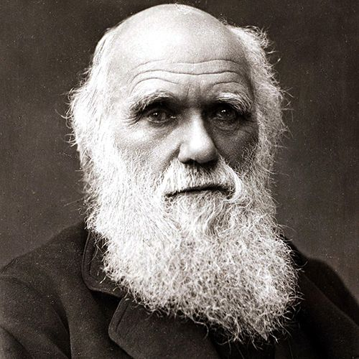

Slide 22
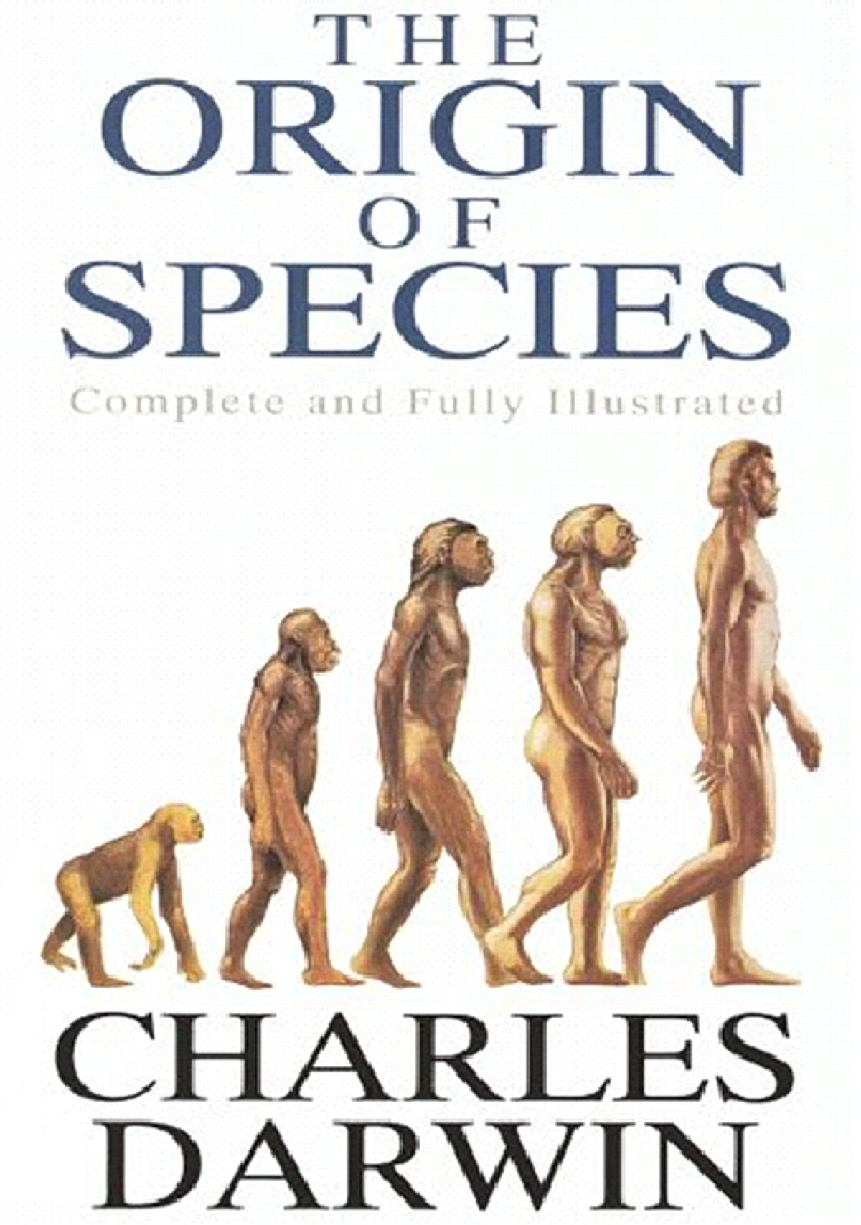
Notes:
Published in 1859

Slide 23

Notes:
Nietzsche wrote of a “madman” who had realized that scientific discovery had destroyed the need for humanity to believe in God. This madman, however, realized what had happened before the culture around him did. They did not understand that there entire culture, all of their values, were built on the idea that there is a God, and that their culture would crumble now that that belief had been destroyed.

Slide 24

Notes:
In order to overcome the death of God, humanity would have to transcend it’s current nature and become the type of being that can create and sustain its own morals. He called this the Übermensch, or “Super-Man”.

Slide 25


Slide 26
6,000,000 Jews Killed

Slide 27
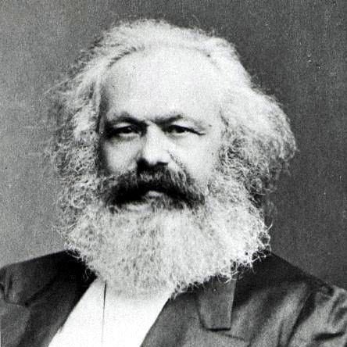

Slide 28
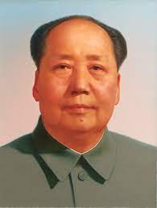


Slide 29
35-70 million killed

Slide 30

Notes:
In order to overcome the death of God, humanity would have to transcend it’s current nature and become the type of being that can create and sustain its own morals. He called this the Übermensch, or “Super-Man”.

Slide 31
Relativism
No Truth

Slide 32


Slide 33
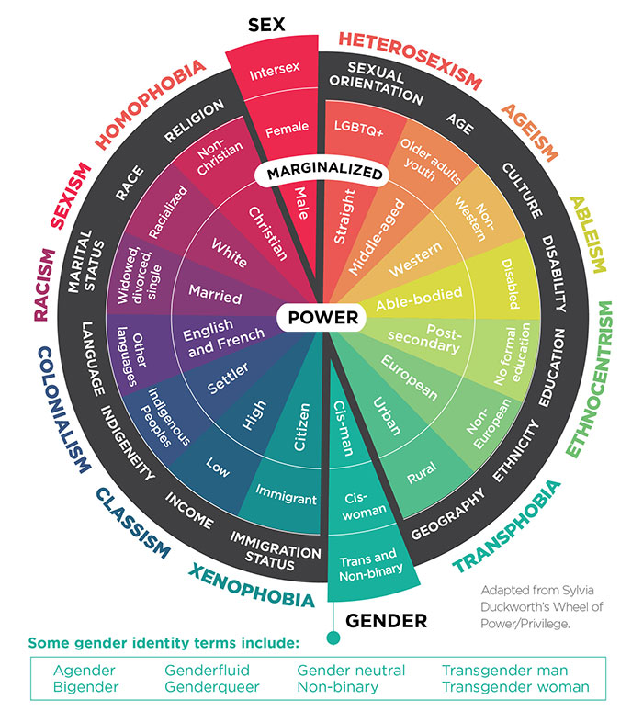

Slide 34

There is no good and evil, there is only power and those too weak to seek it.

Slide 35


Slide 36


Slide 37
Technology
The Rise of the Internet

Slide 38
We’re all dying!!!

Slide 39
2 Options

Slide 40
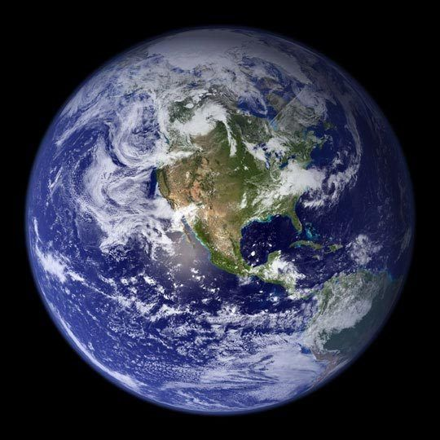
It’s cured!!!
Notes:
Fix the world!

Slide 42
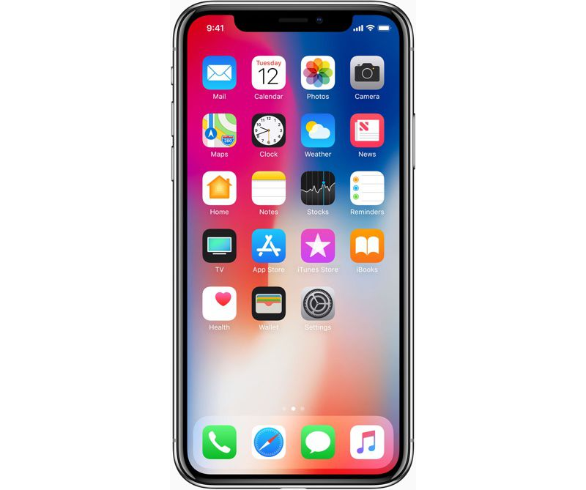
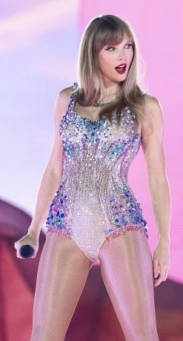
Taylor Swift!!!
Notes:
Distract from the world

Slide 43

Notes:
It is good for humans to be connected to one another.

Slide 44
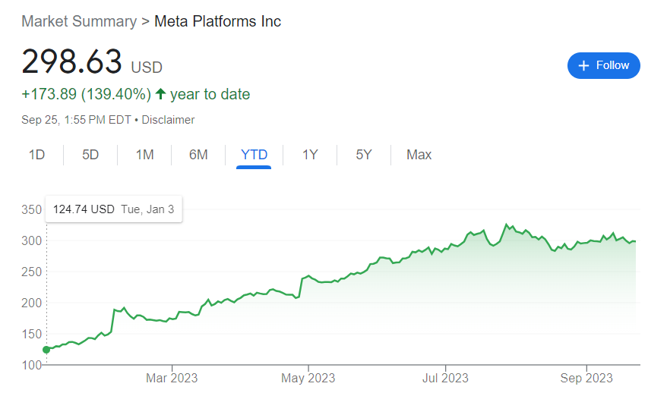

Slide 45

Notes:
Gen Z feels alien to previous generations. They don’t know how to reach them; and their frustration is often apparent.

Slide 46
Nihilism (No Hope)
Relativism (No Truth)
Technology (Only Distraction)
Notes:
The worldview of Gen Z is rooted in a combination of these three philosophical and historical developments.

Slide 47
Part 2: A Biblical Response

Slide 48
Nihilism (No Hope)
Relativism (No Truth)
Technology (Only Distraction)
Notes:
The worldview of Gen Z is rooted in a combination of these three philosophical and historical developments.

Slide 49
Our Story

Slide 50
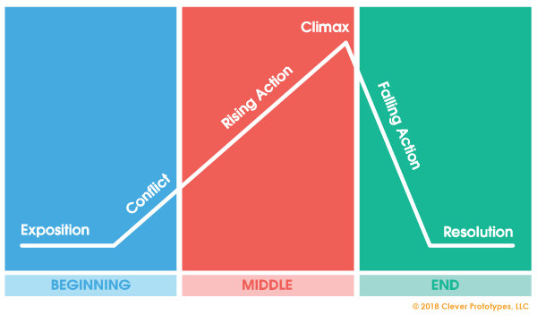

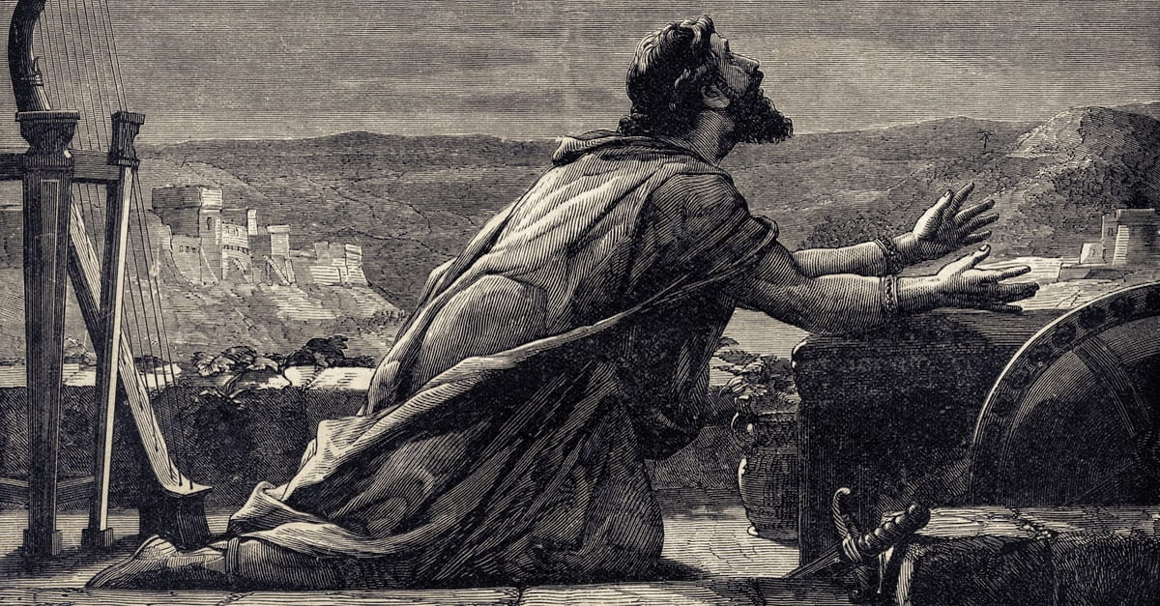
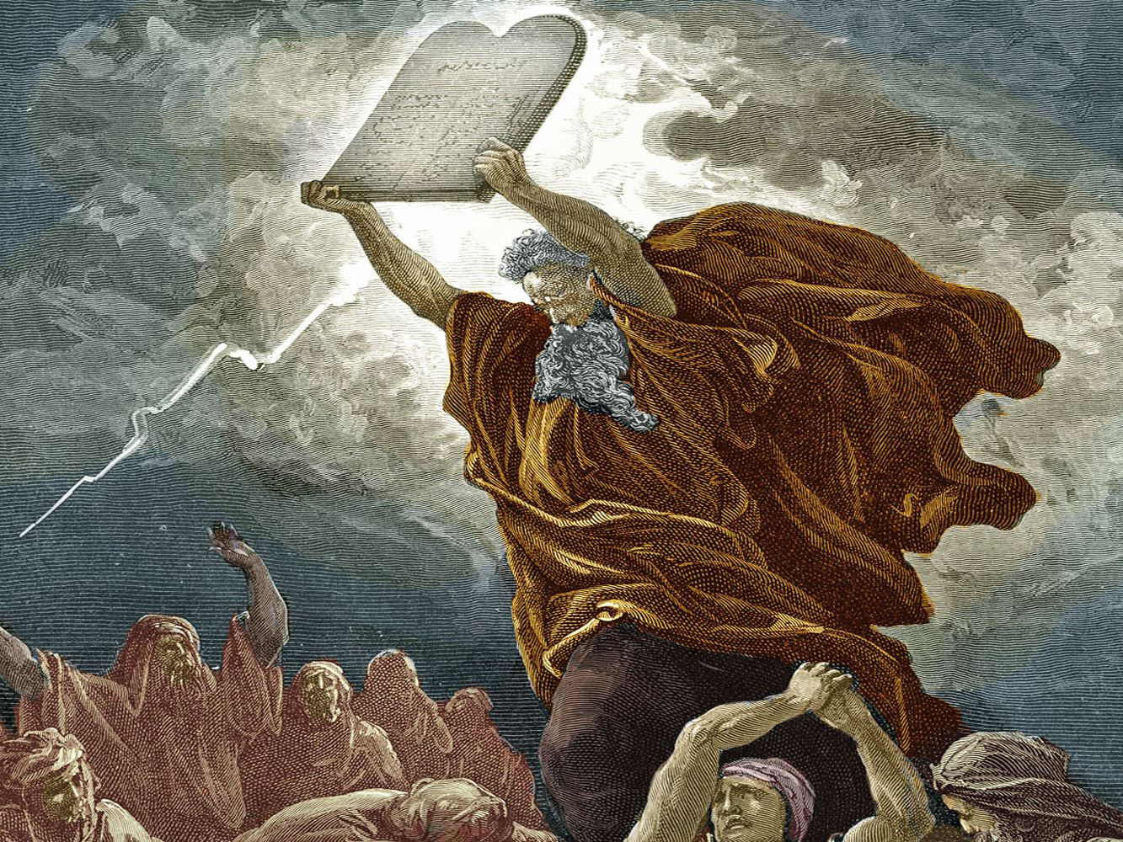

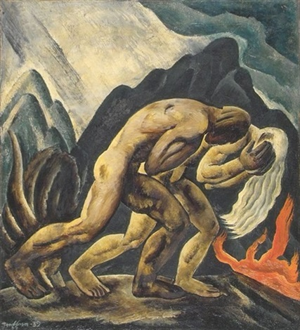
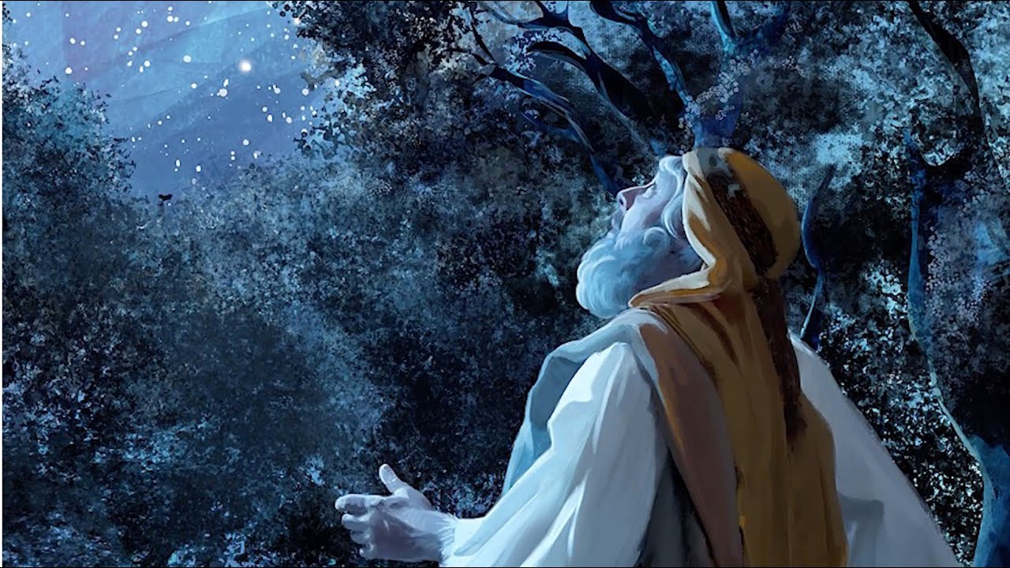
Christianity

Slide 51
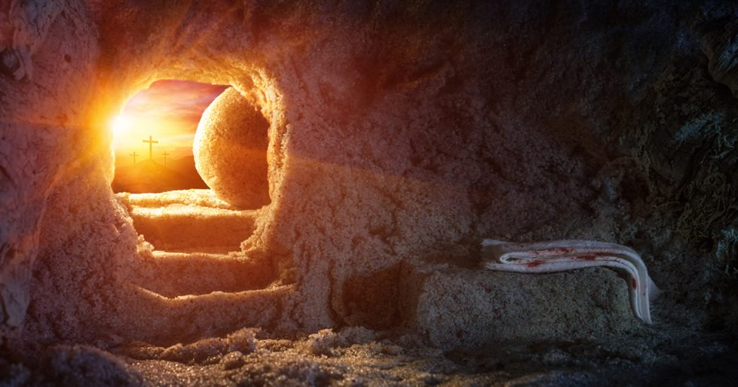
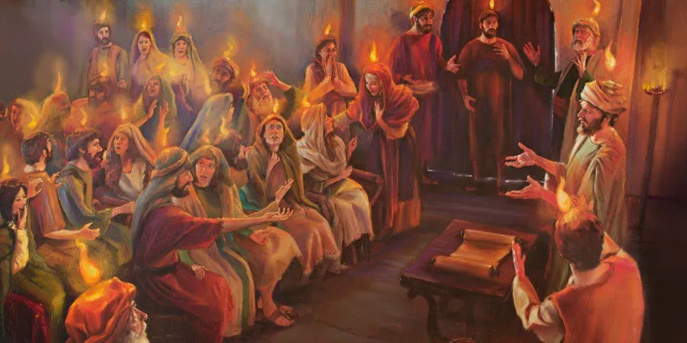


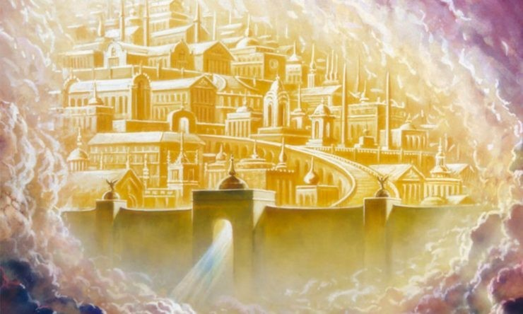
Climax of the Bible

Slide 52
Part 3: Reaching Gen Z

Slide 53
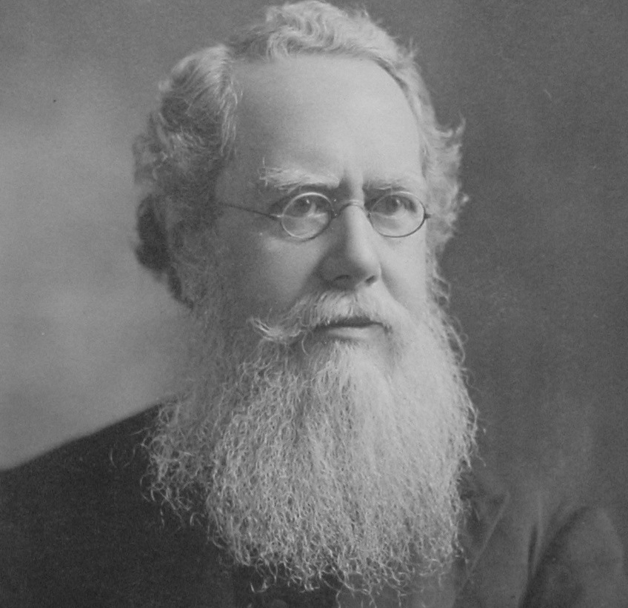
Notes:
How do we learn to speak their language?

Slide 54
Love God
Notes:
The worldview of Gen Z is rooted in a combination of these three philosophical and historical developments.

Slide 55
And you shall love the Lord your God with all your heart and with all your soul and with all your mind and with all your strength.’ - Mark 12:30

Slide 56
Love your neighbor
Notes:
The worldview of Gen Z is rooted in a combination of these three philosophical and historical developments.

Slide 57
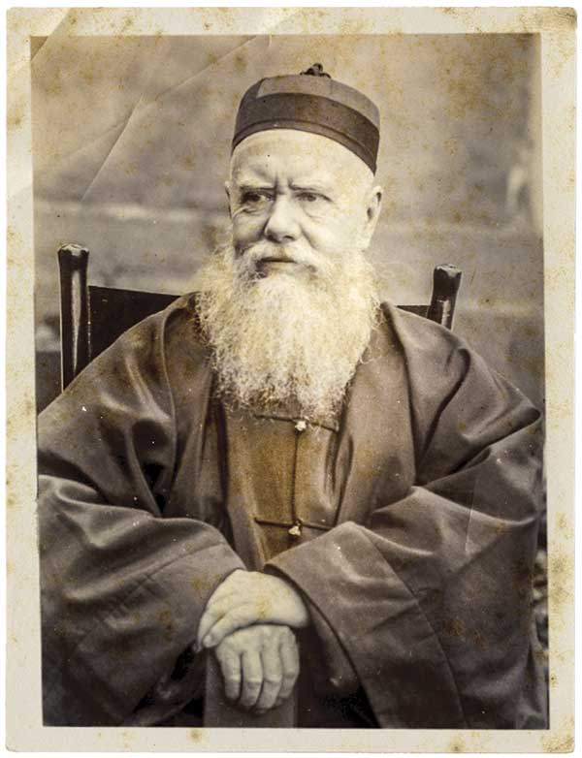
Notes:
In order to minister to the Chinese, he traveled to China, learned the Chinese language, and even dressed like the Chinese dress.

Slide 58
For though I am free from all, I have made myself a servant to all, that I might win more of them. To the Jews I became as a Jew, in order to win Jews. To those under the law I became as one under the law (though not being myself under the law) that I might win those under the law. To those outside the law I became as one outside the law (not being outside the law of God but under the law of Christ) that I might win those outside the law. To the weak I became weak, that I might win the weak. I have become all things to all people, that by all means I might save some.

Slide 59

Culture Translator

Slide 60
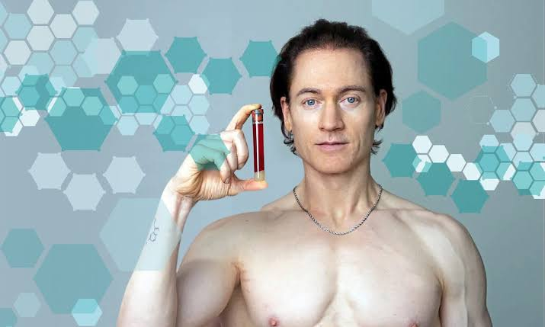

Slide 61


Slide 62
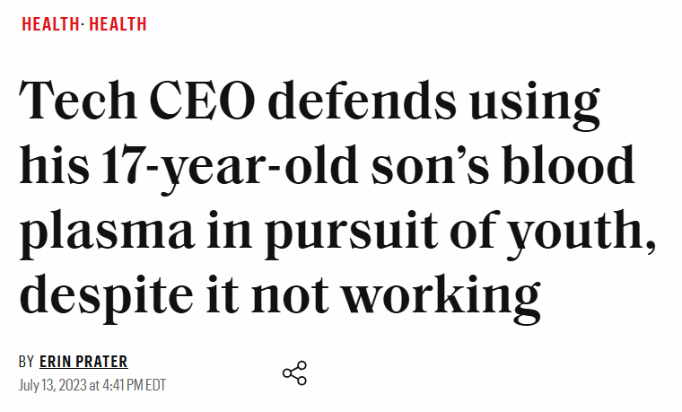

Slide 63
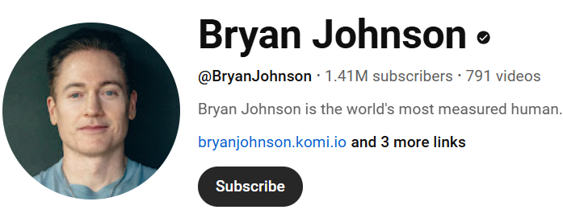

Slide 64



Slide 65
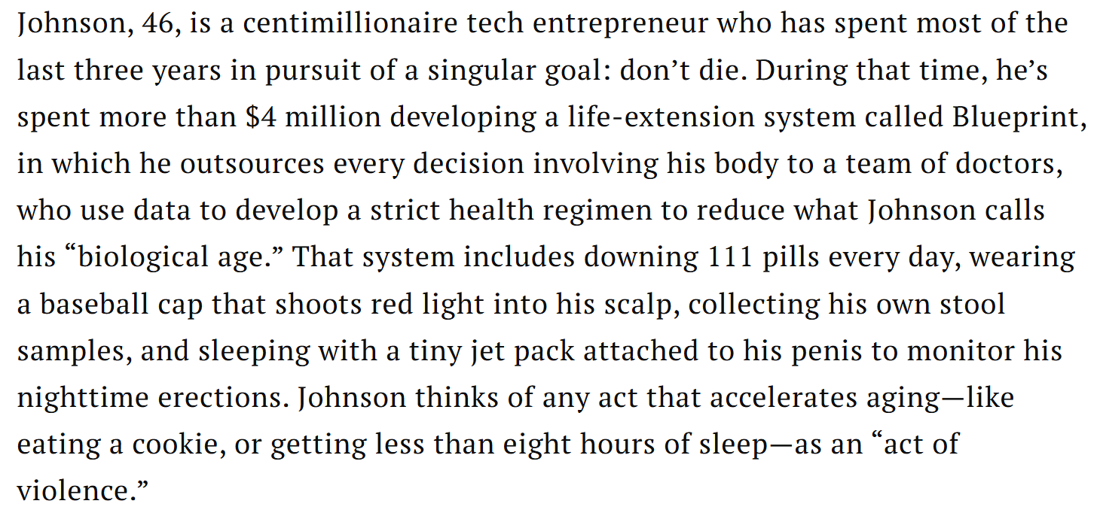

Slide 66
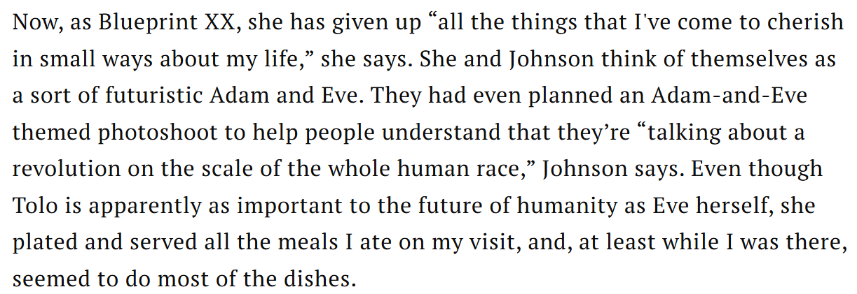

Slide 67


Slide 68



Slide 69

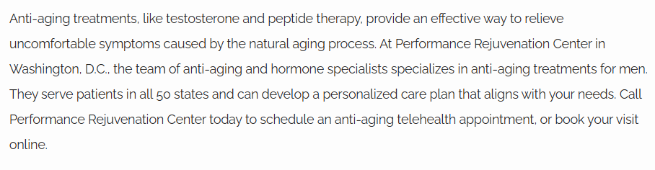

Slide 70



Slide 71
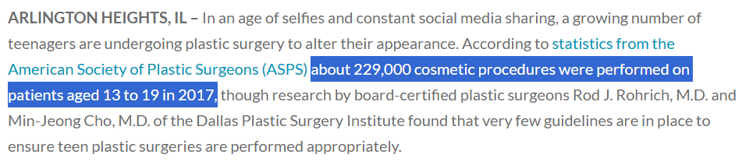

Slide 72

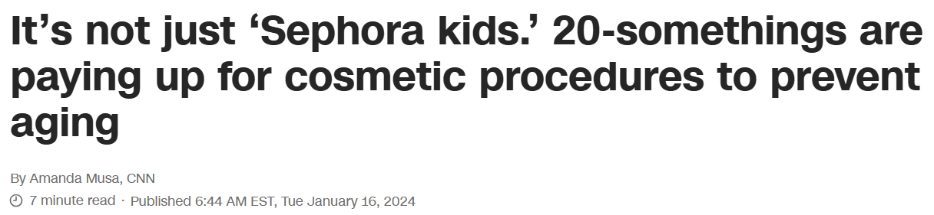

Slide 73
Bible Revival?
If you could live to be 1,000 years old, would you? Why or why not?
Do you think that Bryan Johnson is wrong to pursue immortality? If so, explain why using the Bible.
If what Johnson is doing is wrong, are all anti-aging practices wrong? How do we know which practices are good, and which are bad?

Slide 74
Notes:
In order to minister to the Chinese, he traveled to China, learned the Chinese language, and even dressed like the Chinese dress.

