Slide 1
How to Read Isaiah
Herzog Teacher Training Development Series
Museum of the Bible Teacher Retreat
James Duguid, PhD
July 10th-11th, 2025

Slide 2
Session One: Two Kinds of Righteousness
Thesis: The book of Isaiah is structured around two meanings of the term “righteousness.” When paired with the term “justice,” righteousness refers to the right ethical conduct which God expects of his people. When paired with the term “salvation,” righteousness refers to God’s vindication of his people from their national enemies.

Slide 3
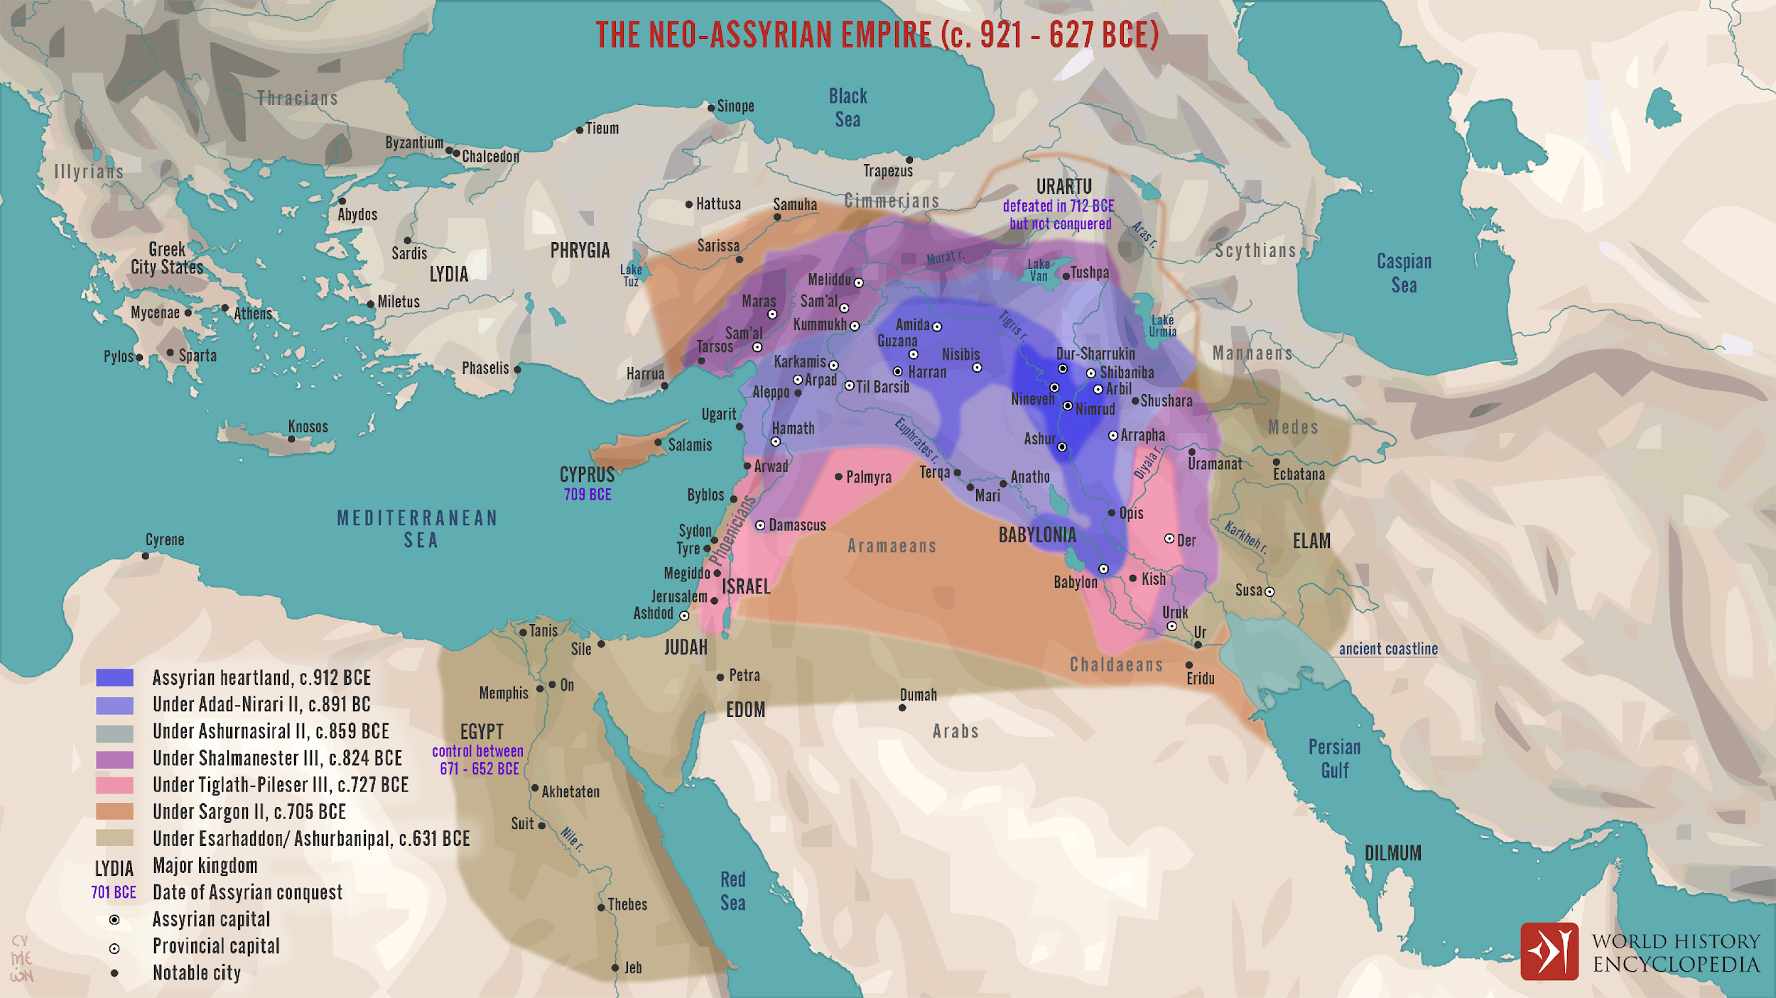

Slide 4
Five Great Empires
Assyria 900-626 BC
Babylon 626-539 BC
Persia 539-331 BC
Greek 331-64 BC
Roman 64 BC – 636 AD

Slide 5
Life and Times of Isaiah son of Amoz
750 BC – Uzziah dies, Isaiah sees his vision in the temple
722 BC – Shalmenezer V conquers Israel, begins deportation
701 BC – Sennacherib campaigns against Judah, but fails to capture Jerusalem
687/6 BC – Mannaseh becomes king, introduces idolatry
641/0 BC – Josiah becomes king, reforms worship
609 BC – Josaih dies. Jehoiakim returns to idolatry
598-7 BC – Nebuchadnezzar captures Jerusalem
586 BC – Nebuchadnezzar destroys Jerusalem, deports elite
539 BC – Cyrus defeats Babylonians, allows Judeans return

Slide 6
Reasons to think Isaiah didn’t write
Isaiah 40-66
Long-term predictive prophecy doesn’t happen.
In these chapters, the judgment that came upon Jerusalem about a century after Isaiah’s time is described as past, and God’s restoration from this judgment as imminent.
In these chapters, Isaiah’s name isn’t mentioned once.
There are theological differences between the two sections.

Slide 7
Responses from traditional
Isaianic authorship view
Isaiah 40-66 seems to claim that long-term predictive prophecy does happen.
Future prophecies can be described as if present.
Much of the substance of the predictions in Isaiah 40-66 is also found in Isaiah 13 and directly attributed to Isaiah son of Amoz (e.g., Babylon defeated by the Medes).
One person’s theology may have paradoxes in it. Declaring two theological themes incompatible is subjective.

Slide 8
Standard Contemporary Scholarly
Theory of Authorship
First Isaiah (ch. 1-39) – contains authentic Isaianic material with many additions
Deutero-Isaiah (ch.40-55) – mostly written by one person around the time of Cyrus
Trito-Isaiah (ch. 56-66) – the work of multiple authors some time after the return from exile

Slide 9
Theological Differences:
Two Kinds of Righteousness?
Rentdorff’s proposal:
First Isaiah pairs “righteousness” with “justice” to describe human ethical conduct.
Deutero-Isaiah pairs “righteousness” with “salvation” to describe God’s deliverance of his people.
Trito-Isaiah integrates these two concepts of righteousness which he finds in the preceding two parts of the book.

Slide 10
Theological Differences:
Two Kinds of Righteousness?
An alternative proposal:
Many allusions to the Elohistic Psalter in Isaiah
In Psalm 71 God’s deliverance is “righteousness and salvation”
Psalm 72 celebrates king of “righteousness and justice”
Editor of the Elohistic Psalter puts these together
Isaiah uses this theme to structure chapters 40-66.
  Chapters 2-39: injustice of people, God’s judgment
  Chapters 40-55: God delivers his people
  Chapters 56-66: people come to embody God’s justice

Slide 11
Activity
Assigned texts
(righteousness and justice)
  (A) Isaiah 5:1-17
  (B) Isaiah 32:1-20
Assigned texts
(righteousness and salvation)
  (C) Isaiah 51:1-16
  (D) Isaiah 46:1-13
(i) Where do you see the terms “righteousness” and “justice” (or, “salvation”)? What do they seem to mean in each occurrence?
(ii) What does this text say about who God is? What does this text say about what God wants from his people?

Slide 12
Activity
(i) What does “righteousness and justice” mean (based on these texts)?
(ii) What does “righteousness and salvation” mean (based on these texts)?

Slide 13
Concluding Remarks
23 For all have sinned and fall short of the glory of God,
24 being put righteous as a gift by his grace through the redemption which is in Christ Jesus, 25 whom God set forth as a propitiation through faith in his blood, for the demonstration of his righteousness on account of overlooking the sins which had previously occurred
26 in the patience of God, for the demonstration of his righteousness in the present time, so that he might be righteous and the one who puts righteous the one who has faith in Jesus.
(Romans 3:23-26)

Slide 14
Session Two: Who is the Child?
I hold it to be a most dangerous mode of interpreting Scripture, to regard everything which its words may be tortured into meaning as a lawful interpretation of the words. I hold undoubtedly that there is a mighty depth in all Scripture, and that in this respect it stands alone. But I also hold that the words of Scripture were intended to have one definite sense, and that our first object should be to discover that sense, and adhere rigidly to it. I believe that, as a general rule, the words of Scripture are intended to have, like all other language, one plain definite meaning, and that to say words do mean a thing, merely because they can be tortured into meaning it, is a most dishonourable and dangerous way of handling Scripture.
- J. C. Ryle

Slide 15
Isaiah 7:14
Therefore, it is my Lord who will give you a sign: Look, the maiden shall conceive, and give birth to a son, and she shall call his name “Immanuel”
[= God with us]

Slide 16
Most popular options to identify the child:
Therefore, it is my Lord who will give you a sign: Look, the maiden shall conceive, and give birth to a son, and she shall call his name “Immanuel” (Isaiah 7:14)
Isaiah’s son Maher-shalal-hash-baz
Ahaz’ son Hezekiah
The Messiah
  But: the child will be young when Assyria destroys the Northern Kingdom

Slide 17
Chronology of Isaiah 7-11
Historical Timeline of Fall of Israel | Ref.
~737-735 BC – Pekah overthrows Menahem’s son in a coup, Israel and Aram join together to invade Judah and organize a counter-Assyrian alliance | Isa 7:1-17
732 BC – Tiglath Pileser III finally defeats Aram and Israel, deports the Galilee region. Rezin and Pekah are deposed, Hoshea becomes king of Israel. | Isa 9:1
727 BC – Shalmenezer V becomes king, Hoshea/Israel rebels against him and he begins campaigning against Israel again. | Isa 9:8-12
722 BC – Sargon II becomes king, defeats Israel, and begins deporting the entire northern kingdom | Isa 10:5-11

Slide 18
Activity
Assigned texts
  (A) Isaiah 8:1-10
  (B) Isaiah 9:1-7
  (C) Isaiah 11:1-10
(i) What links (verbal or conceptual) connect this passage to Isaiah 7:10-17?
(ii) What do these links suggest about the identity of the child in Isaiah 7?

Slide 19
Activity
(i) Based on the evidence from these three passages, who is the child referenced in Isaiah 7:17?

Slide 20
Concluding Remarks
The idea of a single original meaning fixed by grammatical historical interpretation, which is then contrasted to a chain of new reinterpretations through tradition history is a false dichotomy.
Prophecies may be open to multiple meanings already when they are first given.
These multiple meanings may be developed through the short-term history of the prophet’s own ministry, and across the length of time is takes to compose even a short section of a prophetic book.
Futher dimensions of meaning may continue to be unlocked as the writing of the prophet is interpreted down through the ages, but this is not necessarily untrue to the original intention of the prophecy if it was ambiguous already in its original context.

Slide 21
The Servant’s Existential Crisis
The Servant Songs
Isaiah 42:1–4
Isaiah 49:1–6
Isaiah 50:4–11
Isaiah 52:13–53:12

Slide 22
Characteristics of the Servant
just
gentle
wise
teacher of God’s law
persevering through suffering
experiences futility
not visually attractive
man of sorrows
despised and rejected
bears the people’s sin
crushed for the people
silent in affliction
slain
yet somehow also blessed with long life and offspring

Slide 23
Nothingness in Isaiah
All creatures are like nothing compared to God
(Isaiah 40:17)
The gods of the nations are like nothing
(Isaiah 41:24, 29)
God can reduce creation to nothingness but it is not his original intention for it (Isaiah 45:7, 19)
The wicked are like nothing and will come to nothing (Isaiah 41:11-12
God’s Servant experiences nothingness in the futility of his labor (Isaiah 49:4)

Slide 24
Activity
(i) What events does the Servant relate from his past? What is his story with God?
(ii) What do we learn about the Servant’s experience in 49:4? How does this fit with what is said in Isaiah 40-41 about the experience of those who are faithful to God?
(iii) How does God respond to the Servant’s complaint?
(iv) To whom is the Servant speaking in this passage? Who ultimately benefits from his suffering?

Slide 25
Activity
(i) Is it surprising that it is not only the wicked who experience nothingness, but the faithful Servant does too? What does this teach us about the life of faith?

Slide 26
Concluding Remarks
5 Think this inside yourselves which was also in Christ Jesus, 6 who being in the form of God did not consider it a prize to be equal to God, 7 but emptied himself, taking the form of a slave, coming to be in the likeness of humans, and being found in form as a human, 8 he humbled himself, becoming obedient unto death, even death on a cross. 9 Therefore God exalted him, and favored him with the name above every name, 10 that at the name of Jesus every knee would bow, on heaven and on earth and under the earth, 11 and every tongue confess that Jesus Chrsit is Lord, to the glory of God the Father. (Philippians 2:5-11)

Slide 27
Concluding Remarks
For Jesus, simply to become human is to become empty, for all humanity is like nothing compared to God.
The futility of the cross is the ultimate experience of the nothingness of futility, but Jesus nevertheless maintains his faith in God, and is rewarded.
The logic of Isaiah undergirds Paul’s understanding of who Jesus is.

